Slide 1
Python Comprehensions
List Set and Dictionary
Xi Wu(they/them) 09/25/2025

Slide 2
Python Comprehensions
What
Why
When

Slide 3
Python Comprehensions
Syntax
List Comprehension
[ expression for item in iterable if condition ]
{ expression for item in iterable if condition }
{ key_expr : value_expr for item in iterable if condition }
Set Comprehension
Dictionary Comprehension

Slide 4
List Comprehension
What?
List comprehension is a compact syntax in Python that lets you build a new list from an existing iterable in a single line.
-Based on: Python Docs, Data Structure
- Each element can be transformed(e.g., square every number)
- Elements can also be filtered with a condition(optional)

Slide 5
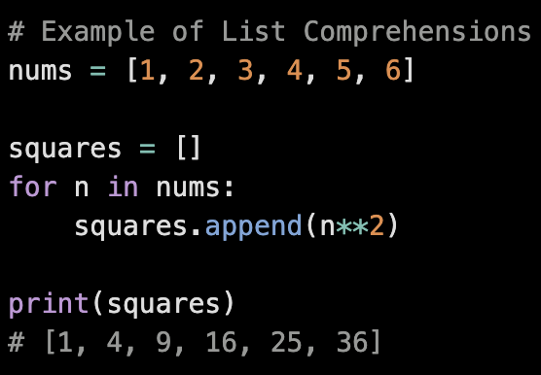
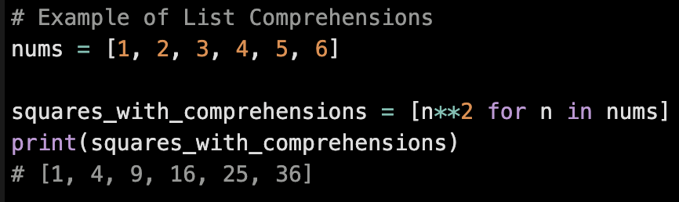
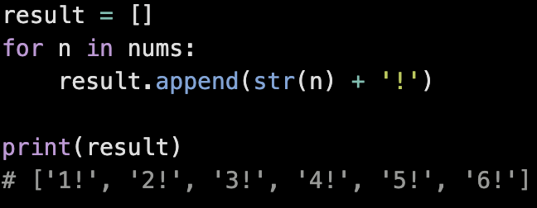
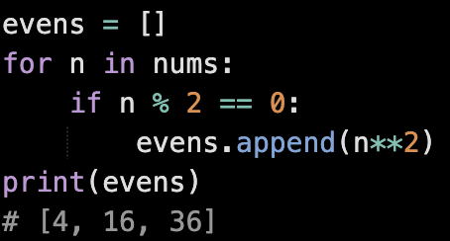
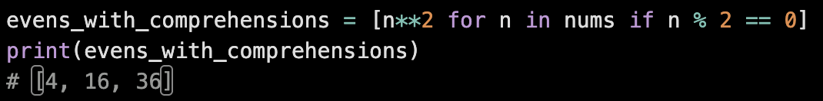
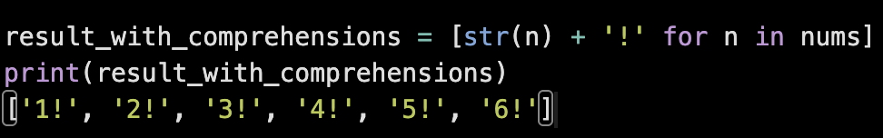
List Comprehension
Examples
Quiz
BLD
Box/Brackets Loop Do

Slide 6
Set Comprehension
What?
Set comprehension is a similar syntax to list comprehension, but it builds a set(unique elements) instead of a list.
-Based on: Python Docs, Data Structure 5.4 Sets

Slide 7
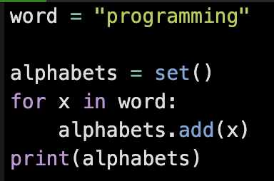
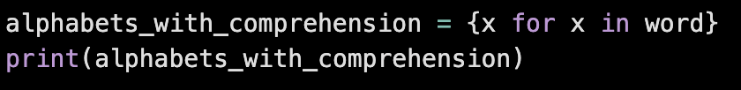


Set Comprehension
Examples “BLD”
Output:
Sets in Python are unordered collections of unique elements

Slide 8
Dictionary Comprehension
What?
Dictionary comprehension lets you build a dictionary from an iterable in a single line, mapping keys to values.
-Based on: Python Docs, Data Structure 5.5 Dictionaries

Slide 9
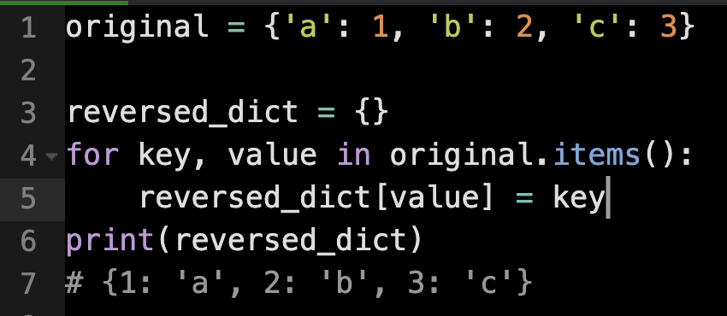
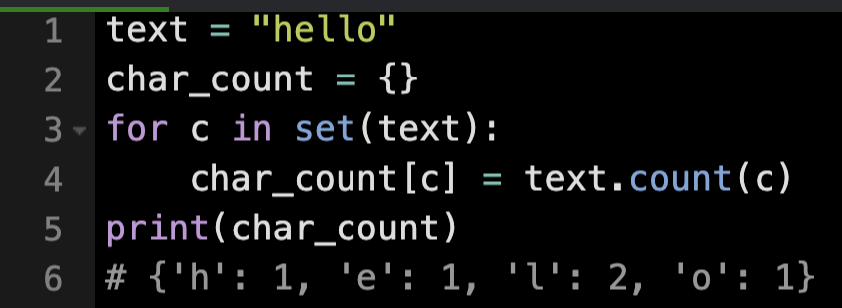
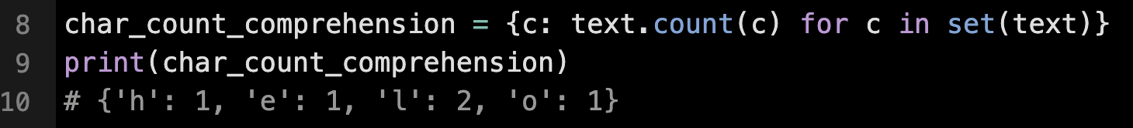
Dictionary Comprehension
Examples “BLD”
c# {'h': 1, 'e': 1, 'l': 2, 'o': 1}
c# {'h': 1, 'e': 1, 'l': 2, 'o': 1}

Slide 10
Python Comprehensions
Why?
Shorter and cleaner than traditional loops
Improves code readability
Efficient for generating or filtering elements
Concise way to handle lists, sets, or dicts

Slide 11
Python Comprehensions
When?
List Comprehension: Generate ordered sequences
Set Comprehension: Remove duplicates automatically/fast membership checks
Dict Comprehension: Create key-value mappings easily

Slide 12
Python Comprehensions
Syntax
List Comprehension
[ expression for item in iterable if condition ]
{ expression for item in iterable if condition }
{ key_expr : value_expr for item in iterable if condition }
Set Comprehension
Dictionary Comprehension

Slide 13
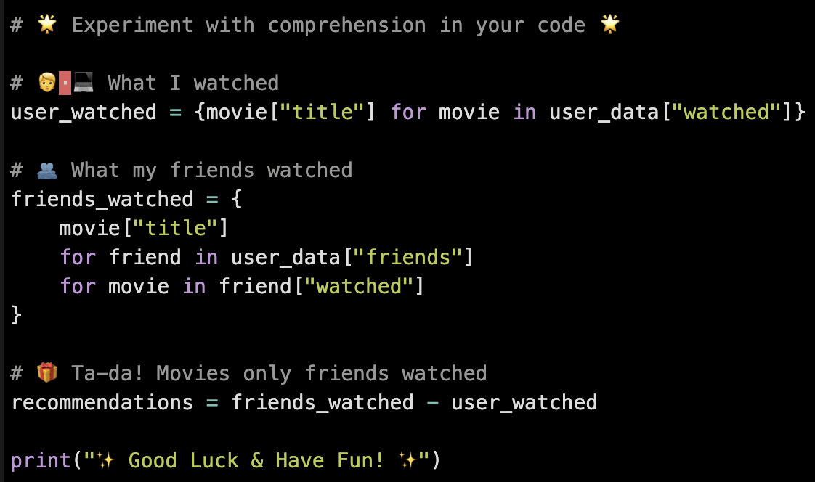
Try Adding Comprehensions to Your Project

